Slide 1
COMP 918: Research Administration for Scientists
Contracts, Grants and Cooperative Agreements: What’s the Difference?
  Tim Quigg, Associate Chair and Lecturer
  Computer Science Department, UNC-Chapel Hill
© Copyright 2012 Timothy L. Quigg All Rights Reserved

Slide 2
Federal Funds
Types of Agreements
  Grants – assistance
  Contracts – procurement/acquisition
  Cooperative Agreements – assistance but with strings attached
  (All definitions and policy discussed in this lecture apply to federally-funded projects only. Private funding agencies often use these terms quite differently, and establish their own policies.)

Slide 3
Grant – a legal instrument for transferring money, property, or services to the recipient in order to accomplish a public purpose of support or stimulation where there will be no substantial involvement between the federal agency and the recipient during performance.
31 U.S.C. 6304

Slide 4
Grants
  May be announced by either Broad Agency Announcements (BAA), Program Solicitations or Program Announcements
  NIH (P01) sample follows!

Slide 5
Part I Overview Information
Department of Health and Human Services
Participating Organizations
National Institutes of Health (NIH), ( http://www.nih.gov/)
Components of Participating Organizations
National Institute of General Medical Sciences (NIGMS), ( http://www.nigms.nih.gov/)
Title: Support of NIGMS Program Project Grants (P01)
Announcement Type
This is a reissue of PA-01-116, which was previously released July 9, 2001.
Update: The following update relating to this announcement has been issued:
September 17, 2007 - Expiration Date adjusted to accommodate recent changes to standing submission deadlines, per NOT-OD-07-093.
Looking Ahead: As part of the Department of Health and Human Services' implementation of e-Government, during FY 2006 the NIH will gradually transition each research grant mechanism to electronic submission through Grants.gov and the use of the SF 424 Research and Related (R&R) forms. Therefore, once the transition is made for a specific grant mechanism, investigators and institutions will be required to submit applications electronically using Grants.gov.. For more information and an initial timeline, see http://era.nih.gov/ElectronicReceipt/. NIH will announce each grant mechanism change in the NIH Guide to Grants and Contracts (http://grants.nih.gov/grants/guide/index.html). Specific funding opportunity announcements will also clearly indicate if Grants.gov submission and the use of the SF424 (R&R) is required. Investigators should consult the NIH Forms and Applications Web site (http://grants.nih.gov/grants/forms.htm) for the most current information when preparing a grant application.

Slide 6
Research Objectives
The program project mechanism is designed to support research in which the funding of several interdependent projects offers significant scientific advantages over support of these same projects as individual regular research grants. NIGMS supports research in the broad areas of Cell Biology and Biophysics; Genetics and Developmental Biology; Pharmacology, Physiology, and Biological Chemistry; and Bioinformatics and Computational Biology. Program project grants are investigator-initiated, but are restricted to areas of special interest to the individual divisions within NIGMS (see http://www.nigms.nih.gov/About/overview for scientific areas of interests). Potential applicants are strongly encouraged to contact the NIGMS program staff listed at the end of this announcement for guidance about the areas appropriate for program project grant applications and for the preparation of the application itself (see www.nigms.nih.gov/Research/Application/ProgProjFundPolicies.htm for policies related to NIGMS program project funding).
Successful program projects generally bring together scientists in diverse fields, who would not otherwise collaborate, to apply complementary approaches to work on an important well-defined problem. Since it is not unusual for principal investigators of individual research grants to share techniques, information, and methods, it is not sufficient that the projects are unified by a common theme. In this regard the burden of proof is on the principal investigator, and on each individual project leader, to demonstrate in the written application that the program would be much less effective if parceled out as a set of independent research grants. In addition, the program project can facilitate the support of essential shared core facilities, e.g., major equipment, although the need of a group of investigators for a major piece of equipment or a core facility does not in itself justify a program project grant. Administrative cores, except in special, well-justified circumstances, will not be allowed. Further, it is expected that successful program projects will establish effective collaborations, particularly in emerging areas of research, that extend beyond the life of the program project grant itself. Hence, a program project generally has a finite lifetime.

Slide 7
1. Mechanism(s) of Support
This funding opportunity will use the National Institutes of Health (NIH) P01 award mechanism.
As an applicant, you will be solely responsible for planning, directing, and executing the proposed project.
This funding opportunity uses the just-in-time budget concepts. It also uses the non-modular budget format described in the PHS 398 application instructions (see http://grants.nih.gov/grants/funding/phs398/phs398.html). A detailed categorical budget for the "Initial Budget Period" and the "Entire Proposed Period of Support" is to be submitted with the application.
2. Funds Available
For applications seeking initial funding in FY2007, an upper limit of $6.1 million direct costs (exclusive of subcontractual facilities and administrative costs) for the entire five-year period may be requested.
Because the nature and scope of the proposed research will vary from application to application, it is anticipated that the size and duration of each award will also vary. Although the financial plans of the IC(s) provide support for this program, awards pursuant to this funding opportunity are contingent upon the availability of funds and the receipt of a sufficient number of meritorious applications.
Facilities and administrative costs requested by consortium participants are not included in the direct cost limitation, see NOT-OD-05-004.
The total project period for an application submitted in response to this PA may not exceed five years. For applications seeking initial funding in FY2007, an upper limit of $6.1 million direct costs (exclusive of subcontractual facilities and administrative costs) for the entire five-year period may be requested. Under certain circumstances, with the concurrence of NIGMS staff, additional funds may be requested and provided for major pieces of equipment. In compliance with NIH policy, a grant application that requests more than $500,000 (direct costs) in any one year will not be accepted without prior approval from the Institute.

Slide 8
Part I Overview Information
Part II Full Text of Announcement
Section I. Funding Opportunity Description
1. Research Objectives
Section II. Award Information
1. Mechanism(s) of Support
2. Funds Available
Section III. Eligibility Information
1. Eligible Applicants
A. Eligible Institutions
B. Eligible Individuals
2.Cost Sharing or Matching
3. Other - Special Eligibility Criteria
Section IV. Application and Submission Information
1. Address to Request Application Information
2. Content and Form of Application Submission
3. Submission Dates and Times
A. Submission, Review, and Anticipated Start Dates
1. Letter of Intent
B. Sending an Application to the NIH
C. Application Processing
4. Intergovernmental Review
5. Funding Restrictions
6. Other Submission Requirements

Slide 9
Section V. Application Review Information
1. Criteria
2. Review and Selection Process
A. Additional Review Criteria
B. Additional Review Considerations
C. Sharing Research Data
D. Sharing Research Resources
3. Anticipated Announcement and Award Dates
Section VI. Award Administration Information
1. Award Notices
2. Administrative and National Policy Requirements
3. Reporting
Section VII. Agency Contact(s)
1. Scientific/Research Contact(s)
2. Peer Review Contact(s)

Slide 10
Grants
  Financial Assistance Award – everyone is listed in the Catalog of Federal Domestic Assistance (CFDA):
      Database maintained by General Services Administration
      Classifies all federal programs
      Each program assigned a number

Slide 11
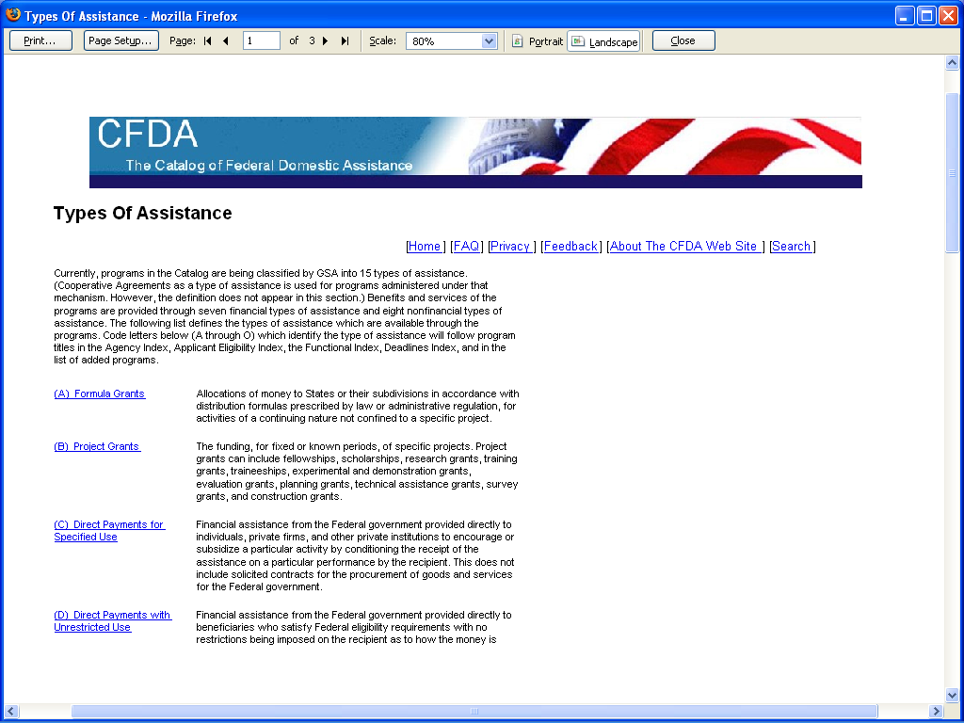

Slide 12
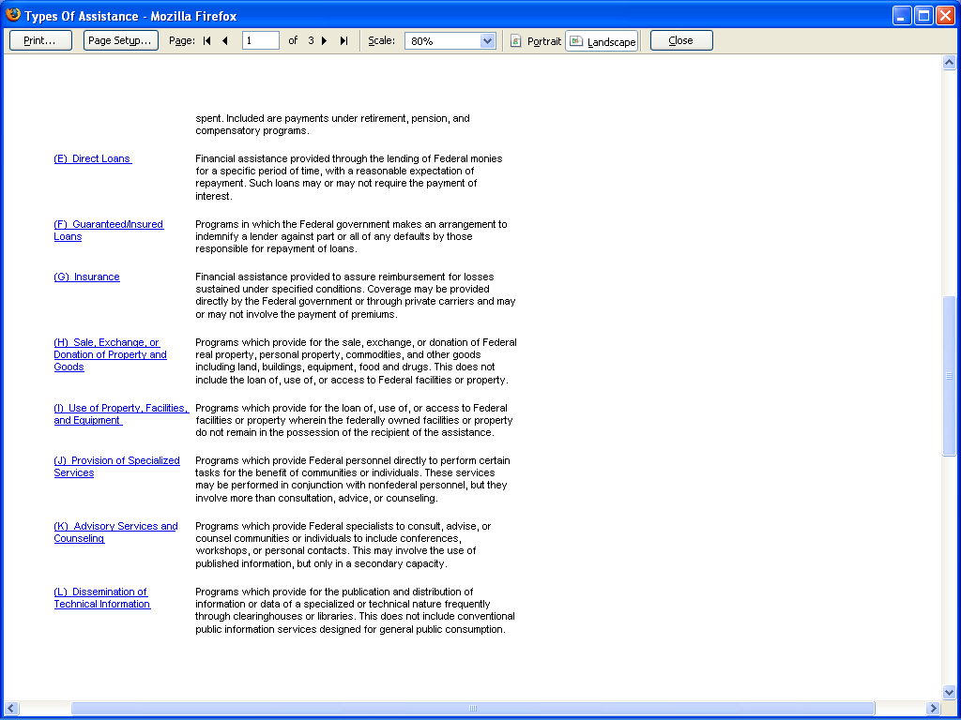

Slide 13
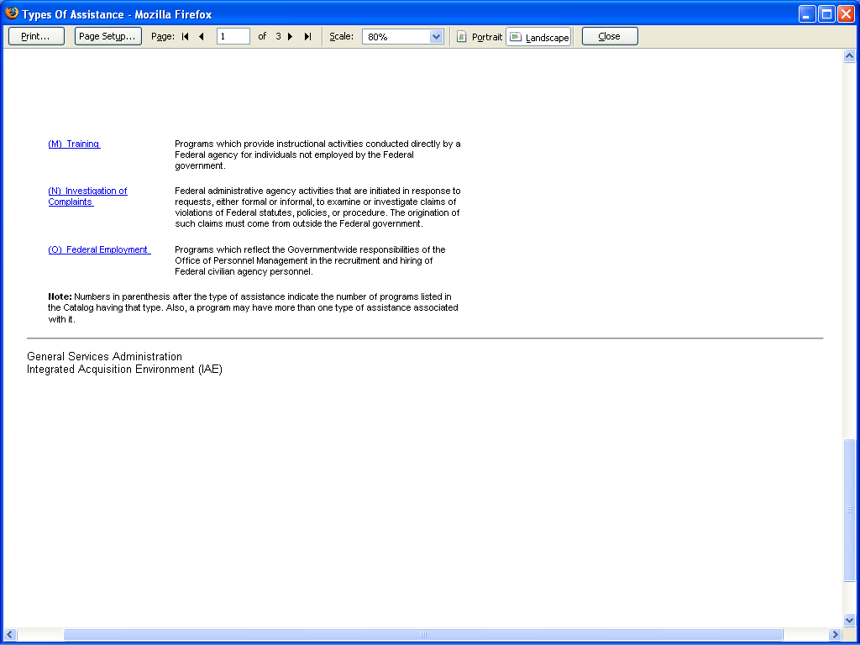

Slide 14
Grants
  Broad Agency Announcements (BAA) or Program Solicitation/Program Announcement
  Financial Assistance Award
  Made for stated purpose (defined in award; note the proposal is incorporated in the award)
  Made for stated period of time (project period or period of performance)
  Made to an organization in the name of a Principal Investigator (PI)
  No substantial programmatic involvement by awarding agency
  Initial funding may be annual, multi-year or for entire project period
  Standard for evaluating performance – “best effort”
  Minimum of limiting conditions

Slide 15
Contract – an agreement, enforceable by law, between two or more competent parties, to do or not do something not prohibited by law, for a legal consideration.
FAR 2.101 defines a contract as a mutually binding legal relationship that obligates the seller to furnish supplies or services and the buyer to pay for them.

Slide 16
Grant – a legal instrument for transferring money, property, or services to the recipient in order to accomplish a public purpose of support or stimulation where there will be no substantial involvement between the federal agency and the recipient during performance.
31 U.S.C. 6304

Slide 17
Contracts
  Announced by either Competitive RFP or BAA
    Competition in Contracting Act of 1984 allowed for basic research proposals to use BAA - otherwise RFP or IFB.
    The Broad Agency Announcement (BAA) is a competitive solicitation procedure used to obtain proposals for basic and applied research when that part of the development is not related to the development of a specific system or hardware procurement. The BAA is described in FAR 6.102, “ Use of Competitive Procedures,” and FAR 35.016, “ Broad Agency Announcements.”
    The type of research solicited under a BAA attempts to increase knowledge in science and/or to advance the state of the art as compared to practical application of knowledge.

Slide 18
Sample BAA for Contracts
N61339-05-R-0095
PART I - INTRODUCTION
AUTHORITY
U.S. Army Research, Development and Engineering Command – Simulation and Training Technology Center (RDECOM-STTC) issues this Broad Agency Announcement (BAA) under the provisions of paragraphs 35.016 and 6.102 (d) (2) of the Federal Acquisition Regulation (FAR), which provides for the competitive selection of research proposals. Contract(s) based on responses to this BAA are in full compliance with the provisions of PL 98-269, “The Competition in Contracting Act of 1984.”
RDECOM-STTC through NAVAIR Orlando Training Systems Division (TSD), contracts with educational institutions, nonprofit organizations, and private industry for research and development (R&D) in those areas covered in Part II of this BAA. Proposed efforts should address issues in all domains including Advanced Concepts and Requirements (ACR) and Research, Development and Acquisition (RDA). Contractors are urged to consider cost sharing schemes in cooperation with RDECOM-STTC. Details of a Cooperative Agreement are provided in Part VI of this document.

Slide 19
Differences Between a BAA and a Competitive RFP
(1) Type of Research and Development
RFP - Focusing on a specific system or hardware solution.
BAA- Scientific study and experimentation directed toward advancing the state-of-the-art or increasing knowledge or understanding.
(2) Statement of Work
RFP- The Government drafts a common SOW to which all offerors propose.
BAA- The Government drafts a statement of the problem or general research interest. Each offeror proposes its own statement of work and technical approach.

Slide 20
Differences Between a BAA and a Competitive RFP
(3) Proposal Comparison
RFP -All proposals are supposed to do the same thing. Winner is selected by comparing proposals.
BAA- Proposals contain stand-alone unique solutions. They are not compared to one another.
(4) Nature of the Competition
RFP- Proposals address common SOW and compete, one against another. Cost, price, or best value, is often the deciding factor.
BAA- Each proposal presents a separate approach to solving the problem. There is technical competition in the “marketplace of ideas.” Cost or price is rarely the deciding factor on the winning proposal.

Slide 21
Differences Between a BAA and a Competitive RFP
(5) Evaluation Process
RFP- An RFP follows very closely a predetermined source selection plan.
BAA- Proposals undergo a scientific review process. A proposal that is otherwise weak could be selected if it shows great technical promise, such as a risky but perhaps revolutionary approach.

Slide 22
Contracts
Contracts
  BAA – Competition in Contracting Act of 1984 allowed for basic research proposals; otherwise RFP or IFB
  Mutually binding legal relationship that binds the seller to deliver certain specified goods or services (deliverables) in exchange for a specified consideration, e.g., money
  Terms are detailed and specific
  Activities largely determined by sponsor (buyer)
  Less latitude to modify scope of work and line-item expenditures
  Funding may be incremental, tied to work components, and final payment (e.g. 10%) may be held till “acceptance” of deliverables
  Standard for evaluating performance – “delivery and acceptance”
  Process governed by the FAR

Slide 23
FAR: Federal Acquisition Regulation
Body of regulations
Chapter 1, Title 48 C.F.R.
Primary source of authority for all government procurements
Maintained jointly by Defense Acquisition Regulatory Council (DARC) and Civilian Agency Acquisition Council (CAAC)
This is the realm of lawyers and highly trained federal procurement specialists!

Slide 24
Contract Types
Cost-Reimbursement Contract (CRC) - FAR 16.302
    Cost-sharing (CSC) – FAR 35.001
    Cost-plus-fixed fee (CPFF) –FAR 16.306 (a)
    Cost-plus-incentive fee (CPIF) – FAR 16.405-1 (a)
    Fixed Price (FPC) FAR 16.202-1
    Firm Fixed Price (FFPC)
    Fixed Price Level of Effort Contract FAR 16.207-1
There are many more, but these are the most important and the ones you are most likely to experience!

Slide 25
Cost-Reimbursement Contract (CRC)
  Pays allowable (and allocable) costs to the extent proposed by seller and funded by buyer
  Contractor must have adequate accounting system to track applicable costs (note: industry often establishes separate divisions for their government work to keep it separate)
  Contains limitation of costs clause (LOC) – parties agree that contract costs will not exceed the estimated cost of the contract.
  Also contains limitation of funds clause (LOF) - when available funding is less than estimated cost of contract, contractor agrees not to exceed the total amount actually allocated.

Slide 26
Cost-sharing (CSC)
  Same as CRC, but with an explicit arrangement under which the contractor bears some of the burden of reasonable, allocable and allowable costs:
  - percentage of total project costs
  - percentage of federal share

Slide 27
Cost-plus-fixed fee (CPFF)
  Same as CRC, but with a negotiated fee fixed at contract inception. It is used when there may be too great a risk to contractors (thus limited interest and little competition) because the cost of the work is difficult to estimate. One problem with this contract type is that it provides little incentive to control costs.

Slide 28
Cost-plus-incentive fee (CPIF)
  Same as CRC, but with a negotiated fixed fee to be adjusted by a formula based on the relationship of total allowable costs to total target costs. In general the fee increases when total allowable costs are less than target costs, and decreases when total allowable costs exceed target costs.

Slide 29
Fixed Price (FPC)
  Price-based, not cost-based (usually determined through competition – bidding!)
  Price defined in contract (total or by unit or by deliverable)
  May include Award Fee (if earned) FAR 16.404(a)
  Price may vary based upon volume, time or economic conditions FAR 16.203-1

Slide 30
Firm Fixed Price (FFPC)
  Same as FPC, but Firm Fixed Price Contract (FFPC) is set with no adjustments
  We have these in CS – If we are able to complete all of the contract requirements (submit all deliverables and have them “accepted”) without spending all of the money, we can keep the profit!
  But if it costs more to complete the contract requirements than is funded, we must cover the extra costs ourselves!

Slide 31
Fixed Price Level of Effort Contract
  Variation of FPC where contractor is to provide specified level of effort over a defined period of time (used for “staffing contracts” where we might provide a scientist for x period for a flat fee)
  Price defined in contract
  All other terms of FPC apply

Slide 32
Contracting Process
Purchase Request (Requisition)
Requirements
Authorization
Administrative Detail
Request for Quotation (RFQ) -
Information Only (Standard Form 18)
Invitation to Bids (IFB)
Procurement
Contract Office
Sealed Bids (offers)
Uniform contract format
Public opening
Price and price-related factors considered
BAA or RFP
Other-than-sealed-bids (offers)
Research Procurements
Uniform contract format
Negotiated procurement
  Bargaining
  Offerors may revise offer
Awards made on quality and cost factors
  Technical excellence
  Management capabilities
  Personnel Qualifications
  Prior experience
Contract Issued

Slide 33
Contract Terminology
  Contracting Officer (CO) – an employee of the federal government with the authority to enter into, administer, and/or terminate contracts. (FAR 2.101)
  Contracting Officer’s Representative (COR/COTR) – an employee of the federal government assigned certain responsibility and authority as delegated from the Contracting Officer.
  Caution: Always be certain the person telling you to do something has the proper authority! This can be particularly “tricky” when dealing with COR’s (your program officer).
  Remember – all changes to a contract must be processed as a “modification”!

Slide 34
Contract Terminology
  Modification – any written change in the terms of a contract (FAR 43.101)
    Change orders
    Supplemental agreements
    Exercises of contract options
    Notices of termination
    Changes in deliverables
    Due dates

Slide 35
Contract Terminology
Contract Terminology
  Estimated Cost – anticipated cost of performance of a cost contract.
  Funding Increment – an amount of funding associated with a period of performance of a contract.
  Established Funding Limit – sum of all funding increments of a contract.
  Reductions in Estimated Cost - Results in descoping (a reduction in the work scope to properly reflect the reduction in cost)

Slide 36
Contract Terminology
  Termination
  For default – right of government to completely or partially terminate a contract because of the contractor’s actual or anticipated failure to perform its contractual obligations (FAR 49.401)
  For convenience – right of government to completely or partially terminate a contract because the CO determines that termination is in the government’s interest (FAR 49.101)

Slide 37
Contract Terminology
Other Contract Issues
  Contract – Acquired Property – property acquired by a contractor for performing a contract to which the government has title.
  Milestones – The government may decide to divide the work into smaller components and establish milestones (with separate deliverables). Payment may be attached to the “acceptance” of each milestone.
  Options - (optional work components or optional time periods) The government may require bidders to submit separate quotes for each option. This gives greater control over the contract work by selectively funding (or not funding) individual options.

Slide 38
Contract Terminology
Other Contract Issues
  Intellectual Property – generally patented inventions are owned by the university under Bayh-Dole provisions and copyright protected works are owned by creator (sometimes by the university if funded under an externally funded award). But there will always be a “government use” provision (and “march-in” rights).
  Rights in Data – if the government has funded development of an item, component, or process, the government may gain unlimited rights to data. If development was at private expense to contractor and is used to fulfill duties under a contract, the government may gain only limited rights.

Slide 39
Cooperative Agreement – a legal instrument for transferring money, property, or services to the recipient in order to accomplish a public purpose of support or stimulation where substantial involvement is expected between the government agency and the recipient.
31 U.S.C. 6305

Slide 40
Cooperative Agreements
Financial Assistance Award as defined by the Federal Grant and Cooperative Agreement Act of 1977
  Similar to grant
    Principal purpose is to transfer money or something of value to recipient in order to accomplish a public purpose (grant language).
    Except – the government anticipates substantial programmatic involvement by funding agency.

Slide 41
Cooperative Agreements
  Agencies have substantial flexibility to structure the terms and conditions (T&Cs)
    But they must issue and post their CA regulations
    Often differ from standard assistance regulations and may even resemble acquisition regulations

Slide 42
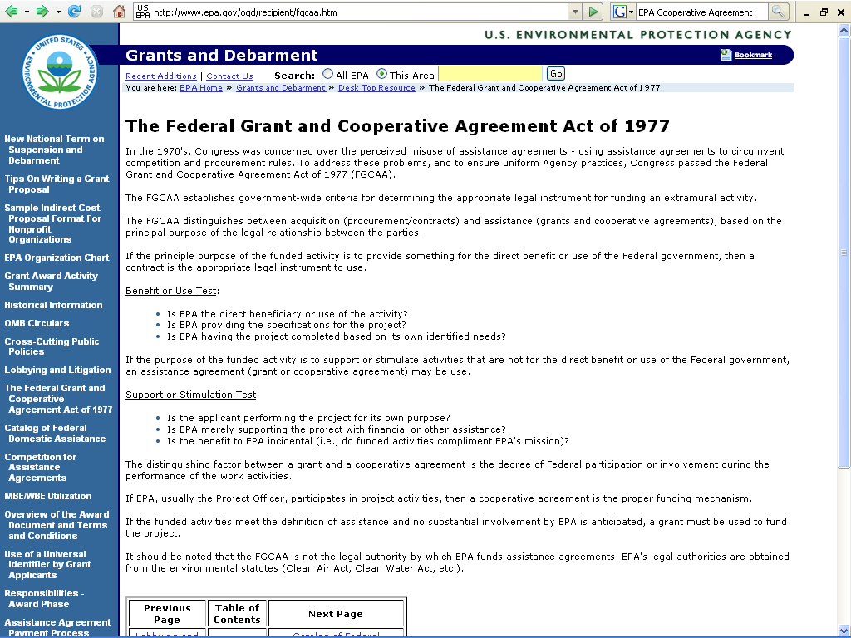

Slide 43
DISTINGUISHING CONTRACT, GRANTS AND COOPERATIVE AGREEMENTS
Substantial Involvement
Government Use
Procurement
Contract
Research
Co-op Agreement
Public Support or Stimulation
Grant
No Substantial Involvement
Idea for the project is initiated by the investigator.
Grantor has no expectation of a specified service or end product
3 P’s – Patron (Grant): Partner (Co-op Agreement): Purchaser (Contract)

Slide 44
Assignment for Next Class
Review the following federal circular before next class:
http://www.whitehouse.gov/omb/circulars/a021/a21_2004.html

